Slide 1
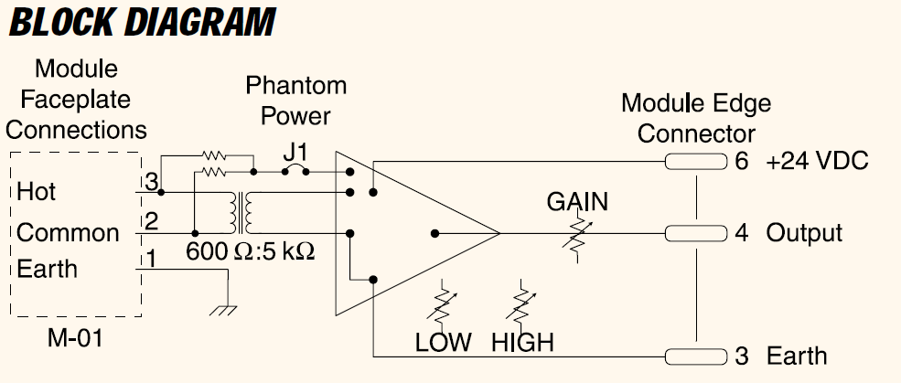
TOA MODULE M-01
TOA brand rack-mount amplifier modules produced in the 1980s-90s

Slide 2
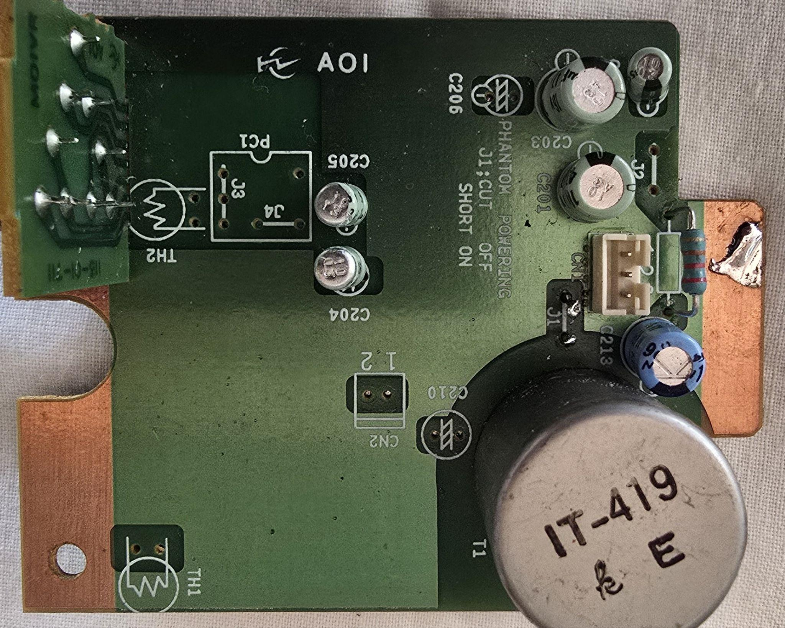
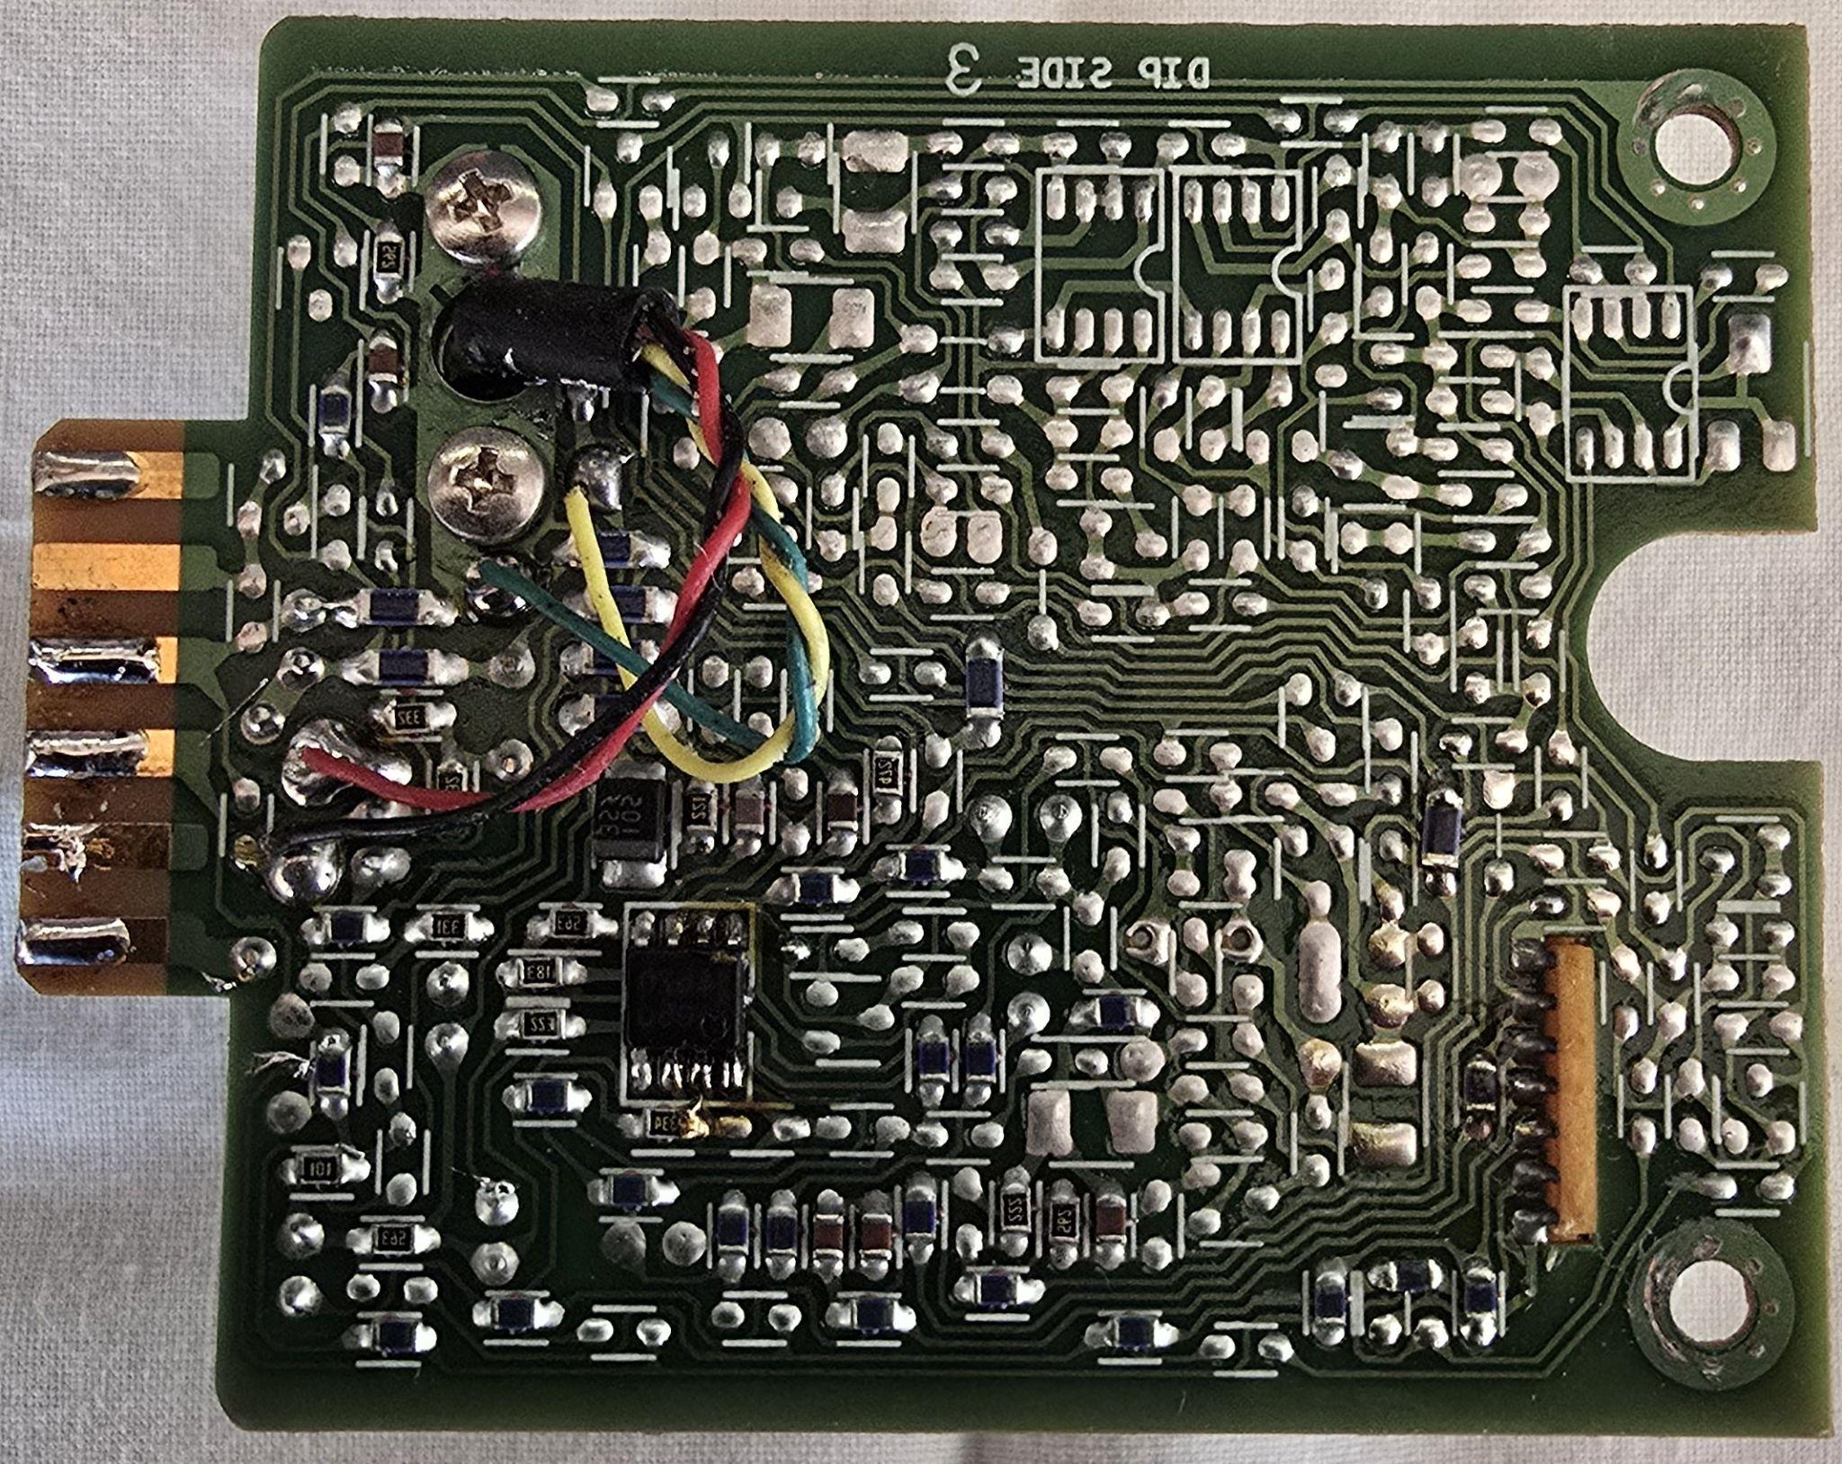
TOP (LOOKING FROM TOP)
BOTTOM (LOOKING FROM BOTTOM)

Slide 3
TOA MODULE M-01
XX
CAPACITORS
XX = TANTALUM ?
XXX
562
XX
XXX
6. +24VDC
XXX
5. MIX OUT
XXX
XXX
XX
XXX
XXX
4. SIGNAL (OUTPUT)
XXX
332
3. COMMON (EARTH)
472
332
XX
221
XX
XXX
XXX
2. MUTE BUS 1
XXX
563
331
XXX
1. UTE BUS 2
183
XXX
XX
223
XXX
XX
XXX
IC1 UPC4570
334
XXX
XX
222
XX
XXX
101
DIODE _105 35_ (MURS105 875mV@1A) ??
567
XX
XXX
XXX
XX
563
XXX
XXX
XXX
XXX
XXX
XXX
XXX
XXX
SMD COMPONENTS

Slide 4
TOA MODULE M-01
C208 POL CAP 10uF 16V
C203 POL CAP 47uF 16V
TONE CONTROLS
C201 POL CAP 47uF 16V
C205 POL CAP 2.2uF 50V
R127 RESISTOR 220 Ohm
C204 POL CAP 10uF 16V
CN1 INPUT CONNECTOR
J1 PHANTOM POWER
C213 POL CAP 100uF 25V
TRANSFORMER CONNECTION POINTS
AUDIO ISOLATION TRANSFORMER
THROUGH HOLE COMPONENTS

Slide 5
TOA MODULE M-01
INPUT CONNECTION
EARTH
COLD
HOT
CN1 INPUT CONNECTION
J1 PHANTOM POWER JUMPER
EXTERNAL CONNECTORS

Slide 6
TOA MODULE M-01
PIN 1
PIN 2
PIN 3
PIN 4
PIN 5
PIN 6
PIN 7
TONE CONTROLS
IC1
4570 is an ultra low-noise, wideband high slew-rate, dual operational amplifier
LOW 47k
PIN 4
PIN 5
HIGH 47k
PIN 6
PIN 7
GAIN 47k
PIN 1
PIN 2
PIN 3
TONE CONTROL BOARD COMPONENTS

Slide 7
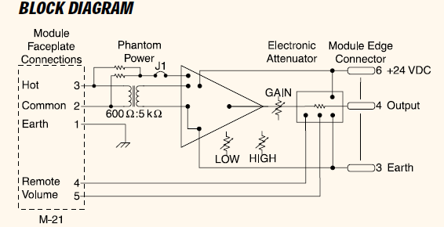
TOA MODULE M-21S

Slide 8
TOA MODULE M-21S
TOP (LOOKING FROM TOP)
BOTTOM (LOOKING FROM BOTTOM)

